Slide 1
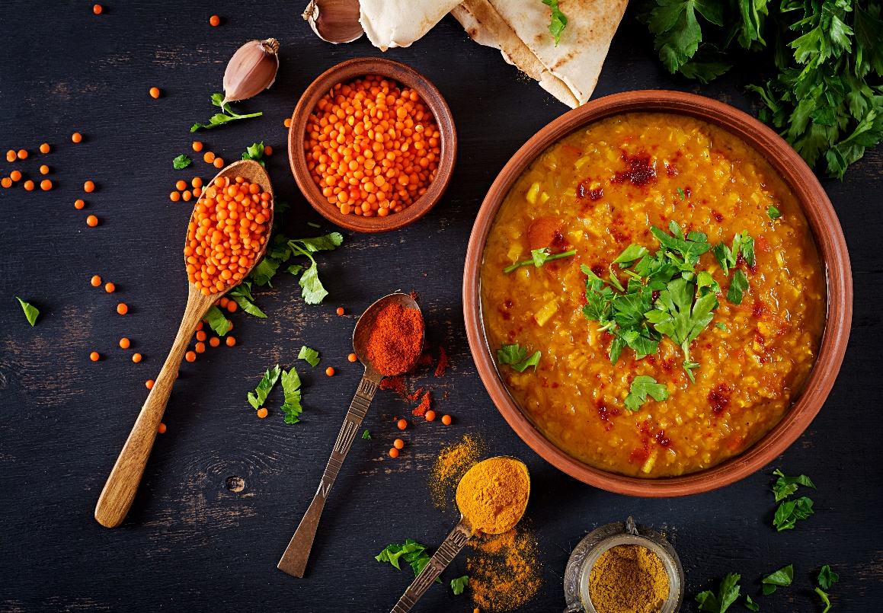
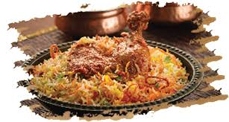
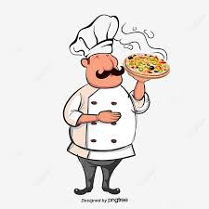
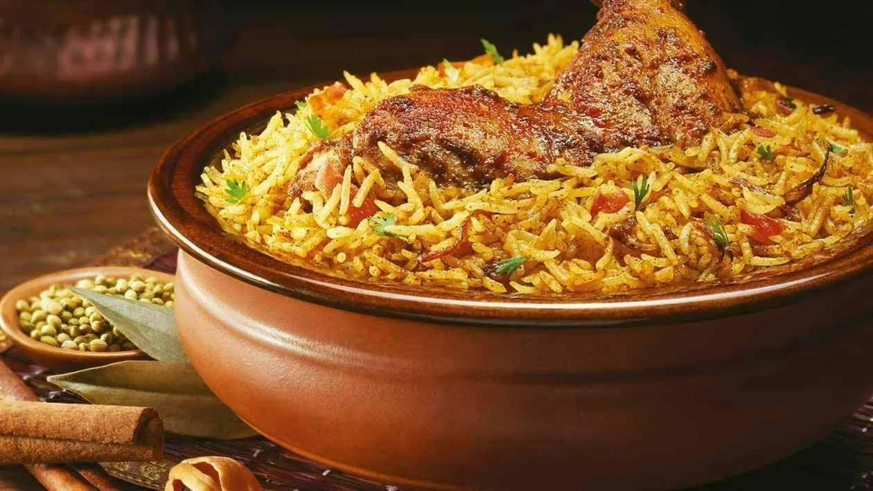
FOOD ORDER PROJECT
by VIJAYALAKSHMI

Slide 2
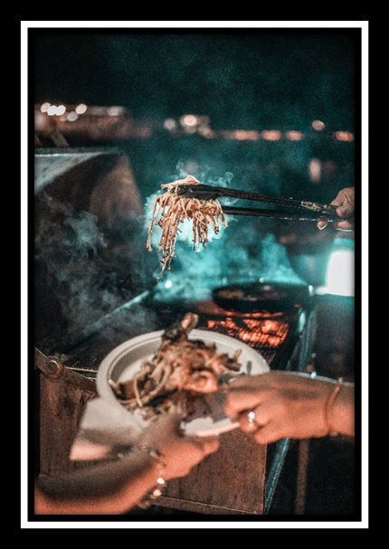
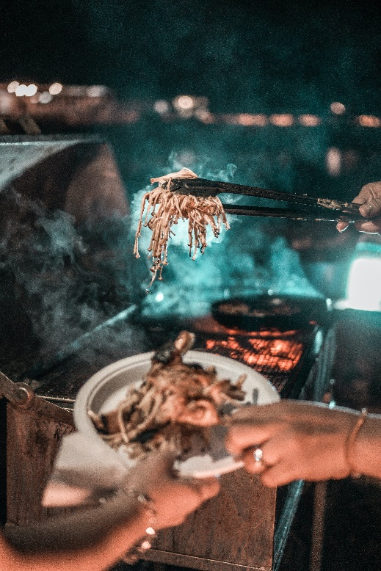
ABSTRACT
It Typically deals with Delivering Food at Door Step.
Provide Safe and Simple Interactions. (Between Customer and Administration)
Generate records Of Received Orders, Processed Orders and Delivery Status. (Avoid Confusion)

Slide 3
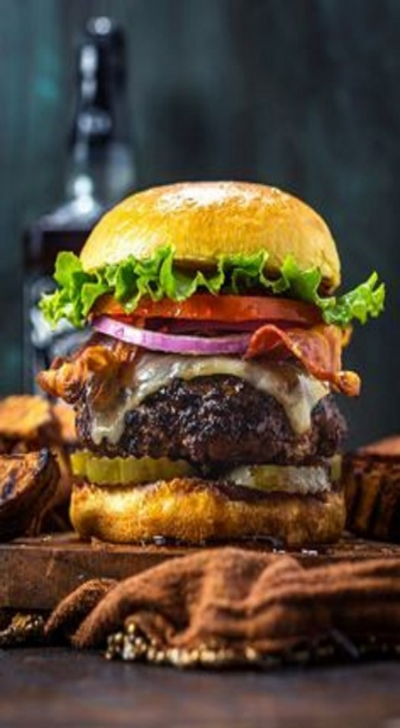
. INTRODUCTION
The System deals with ordering, Processing and Delivering Food Products.
Ordering is done by a Valid Customer with appropriate identity.
The Administration Receives Order, Acknowledges the Customer, Process them and Assures Correct Delivery.

Slide 4

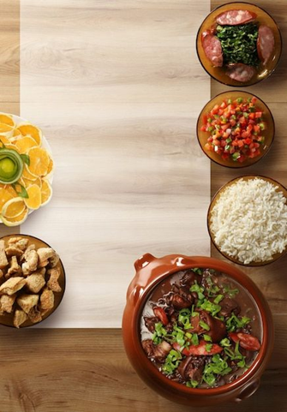

PROPOSED SYSTEM
Instantaneous Online Food Order Process System.
Deals With Registering Of Food Products, Price List and Availability. Allows Frequent Updating.
Allows Valid Customer To Book His/Her Order and make them Delivered.
Maintains Record Of Received Orders, Processed Orders and Delivery Status.

Slide 5

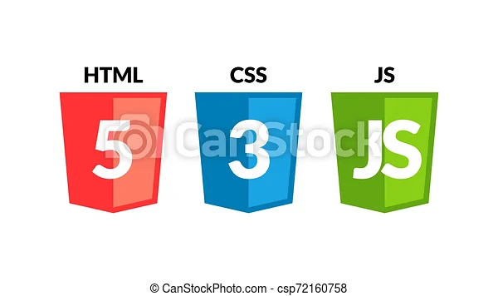

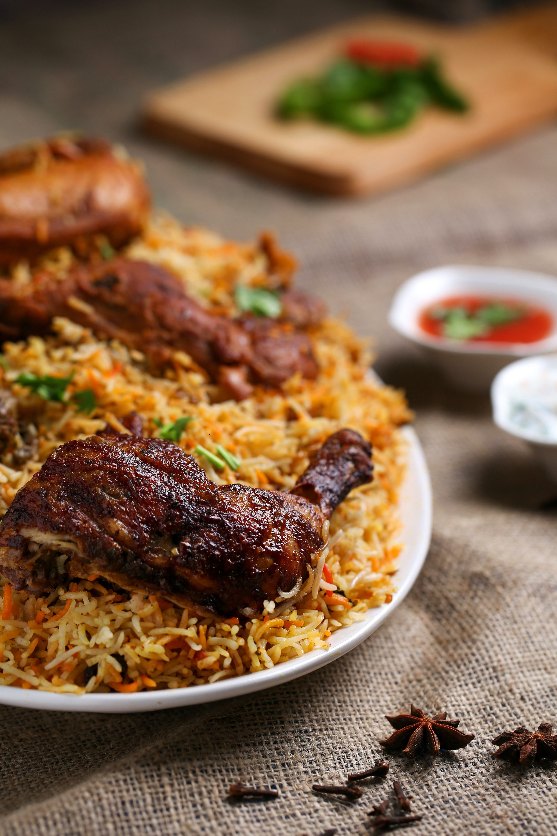

SOFTWARE REQUIREMENTS

Slide 6
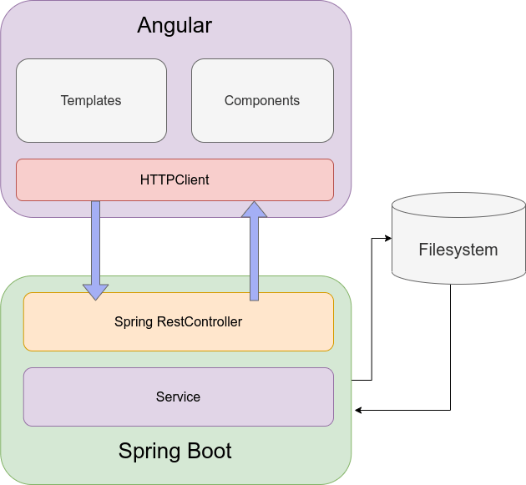
ARCHITECTURE

Slide 7
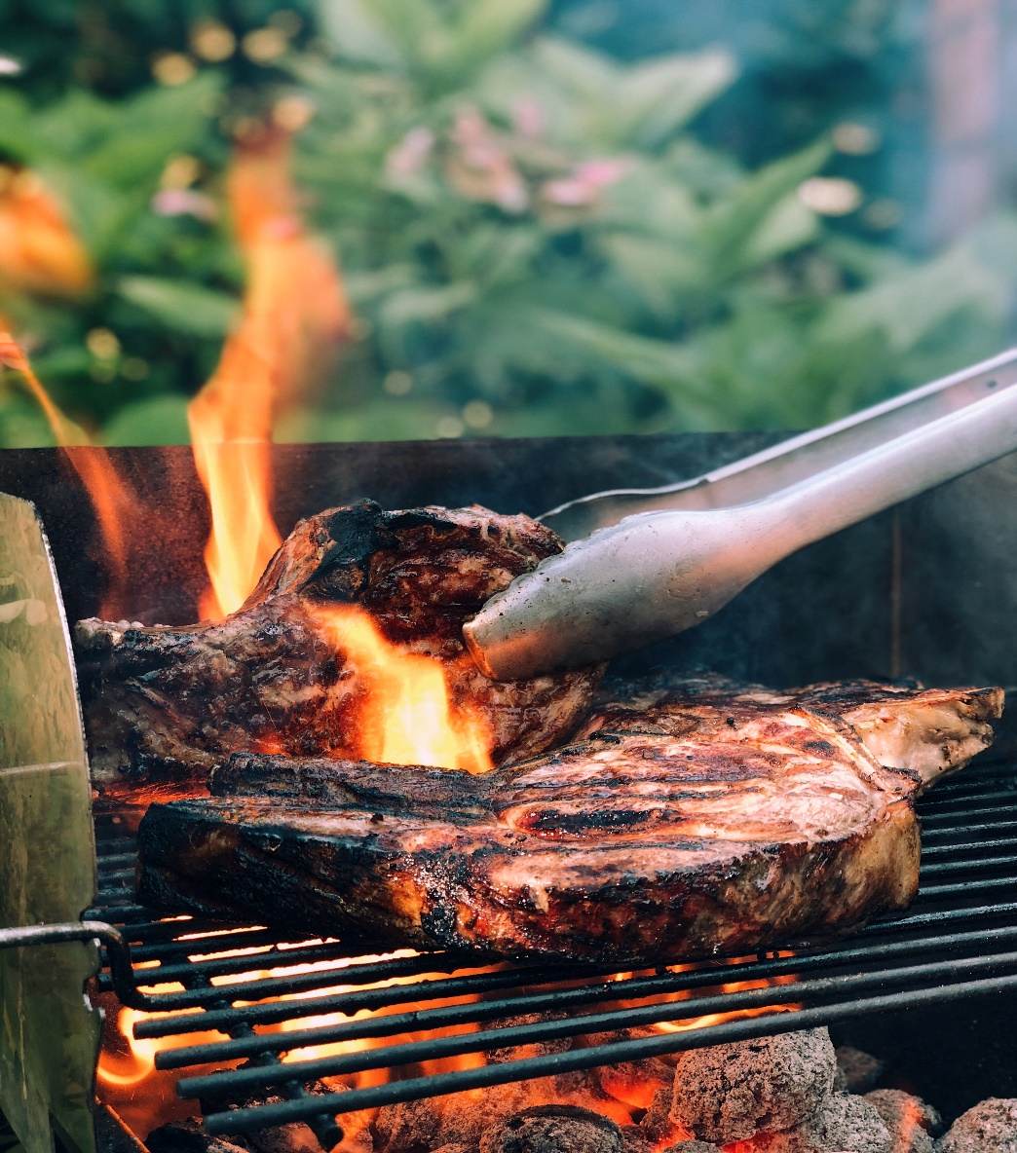
HARDWARE REQUIREMENTS
Processor (PIV)
RAM ( 512 MB)
Hard Disk ( 10 GB Space)
A Monitor ( VGA color(256)).

Slide 8
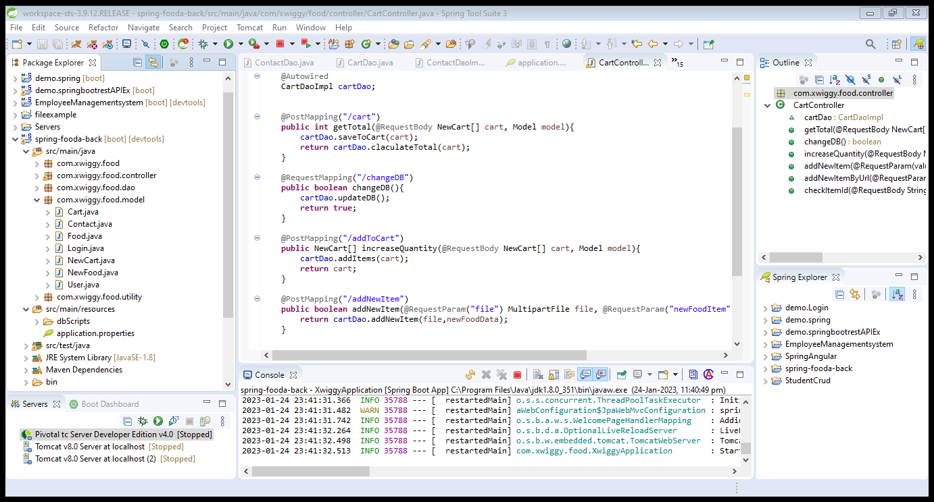
SCREENSHOT SPRINGBOOT SOFTWARE

Slide 9
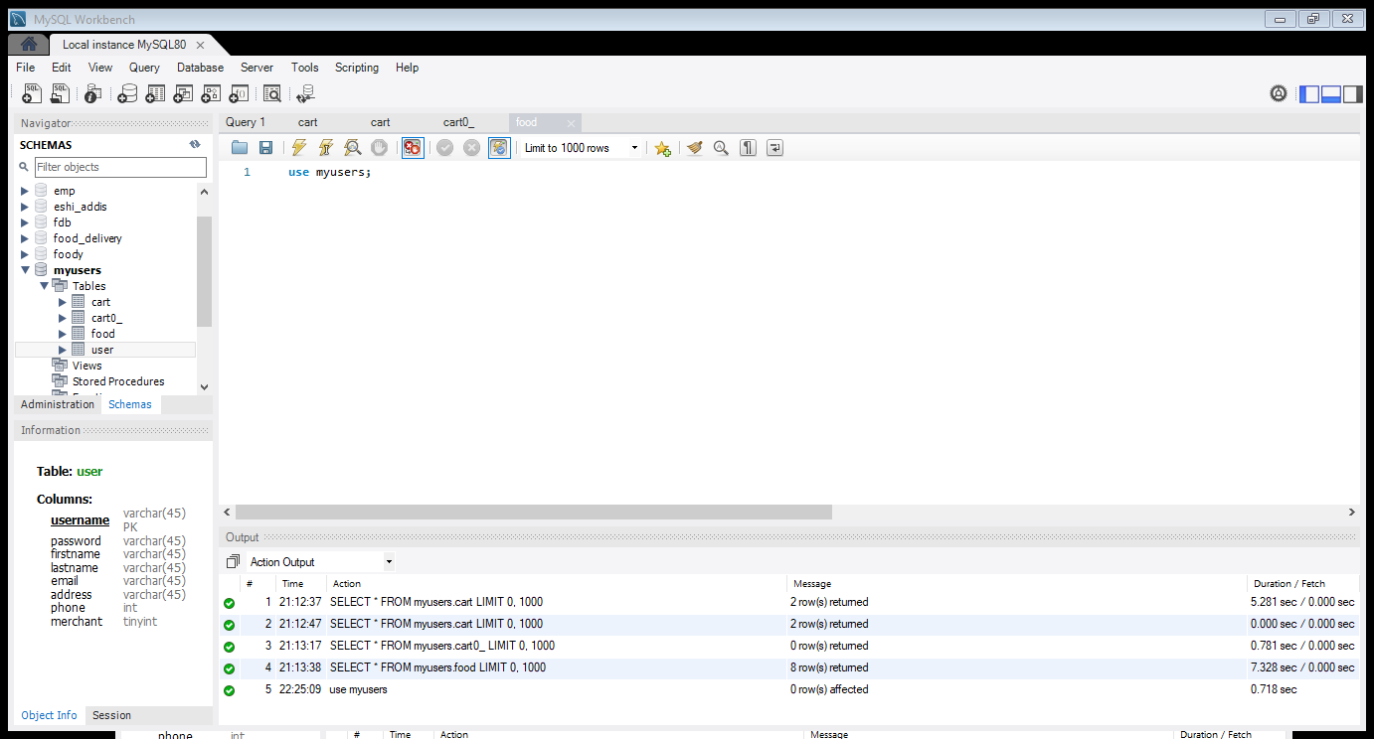
SCREENSHOT OF MYSQL SOFTWARE

Slide 10
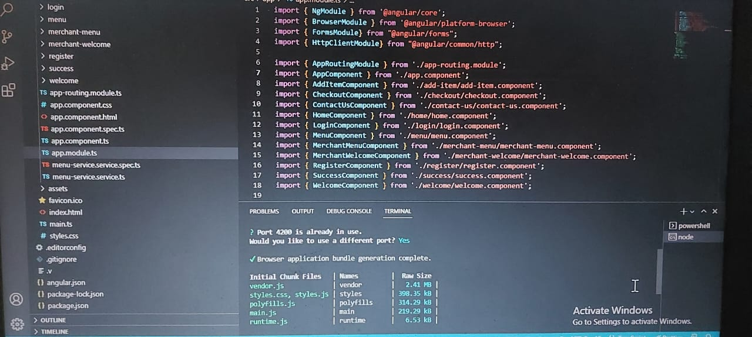
SCREENSHOT OF ANGULAR SOFTWARE

Slide 11
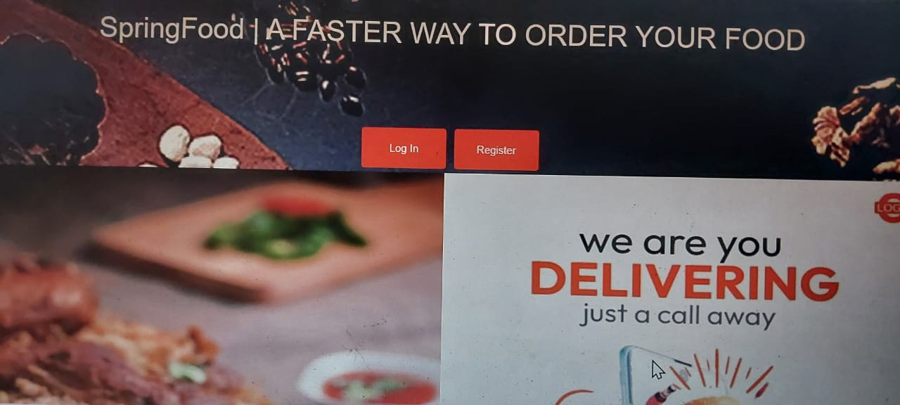
FOOD ORDER APPLICATION OUTPUT

Slide 12
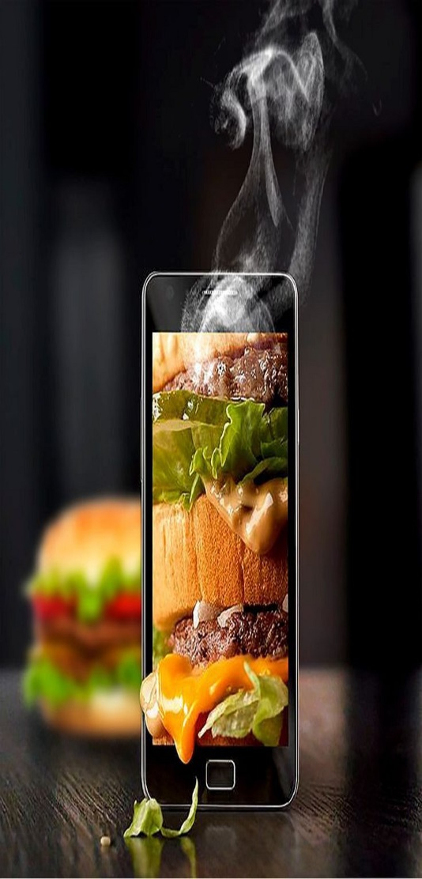
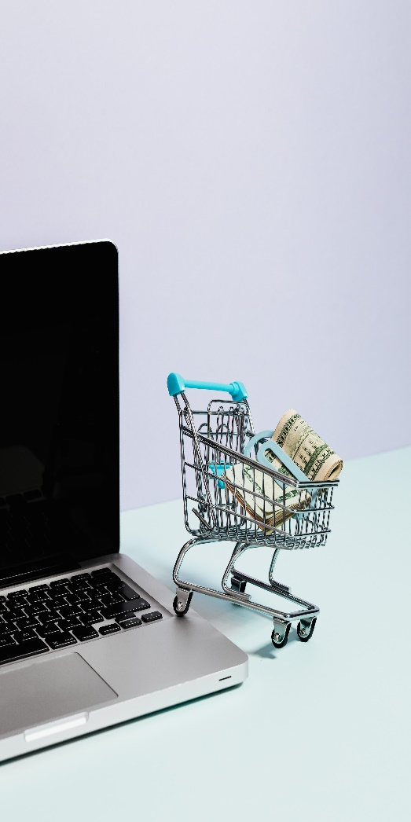
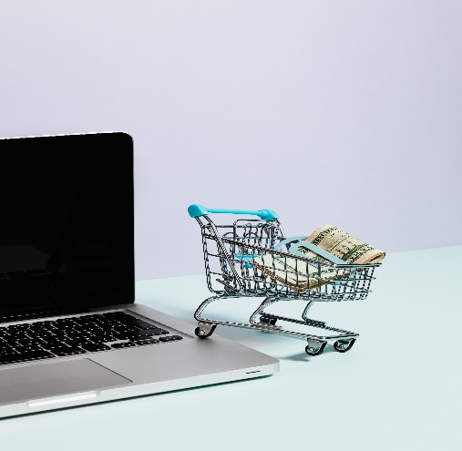
LOGIN AND SECURITY
The Administration and Customer are provided with separate User Id’s and passwords.
Only the Valid Administration and Customer are allowed to access the System based on Access rights provided to them.
Product And Pricelist Administration :In this module the administrator is facilitated to Showcase the Food Products available and their Price list. This Module helps in making Frequent updations based on Availability and Offer’s provided.

Slide 13
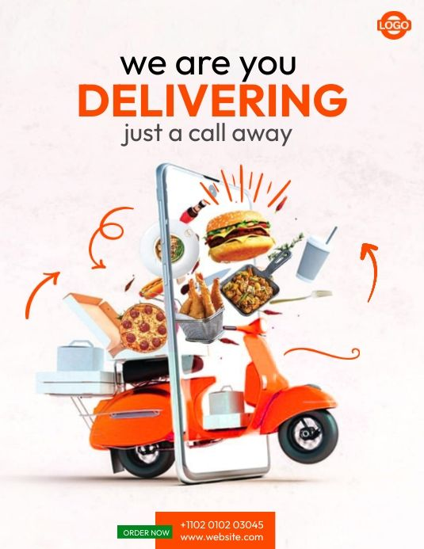
ADVANTAGES
Easy in Process.
Only Valid Customer is Allowed To Make Orders.
Consumes Limited Time.
Avoids Overhead Of Arriving or Contacting To The Restaurant.
No Repeated Intimation To be Done By The Administrator.

Slide 14
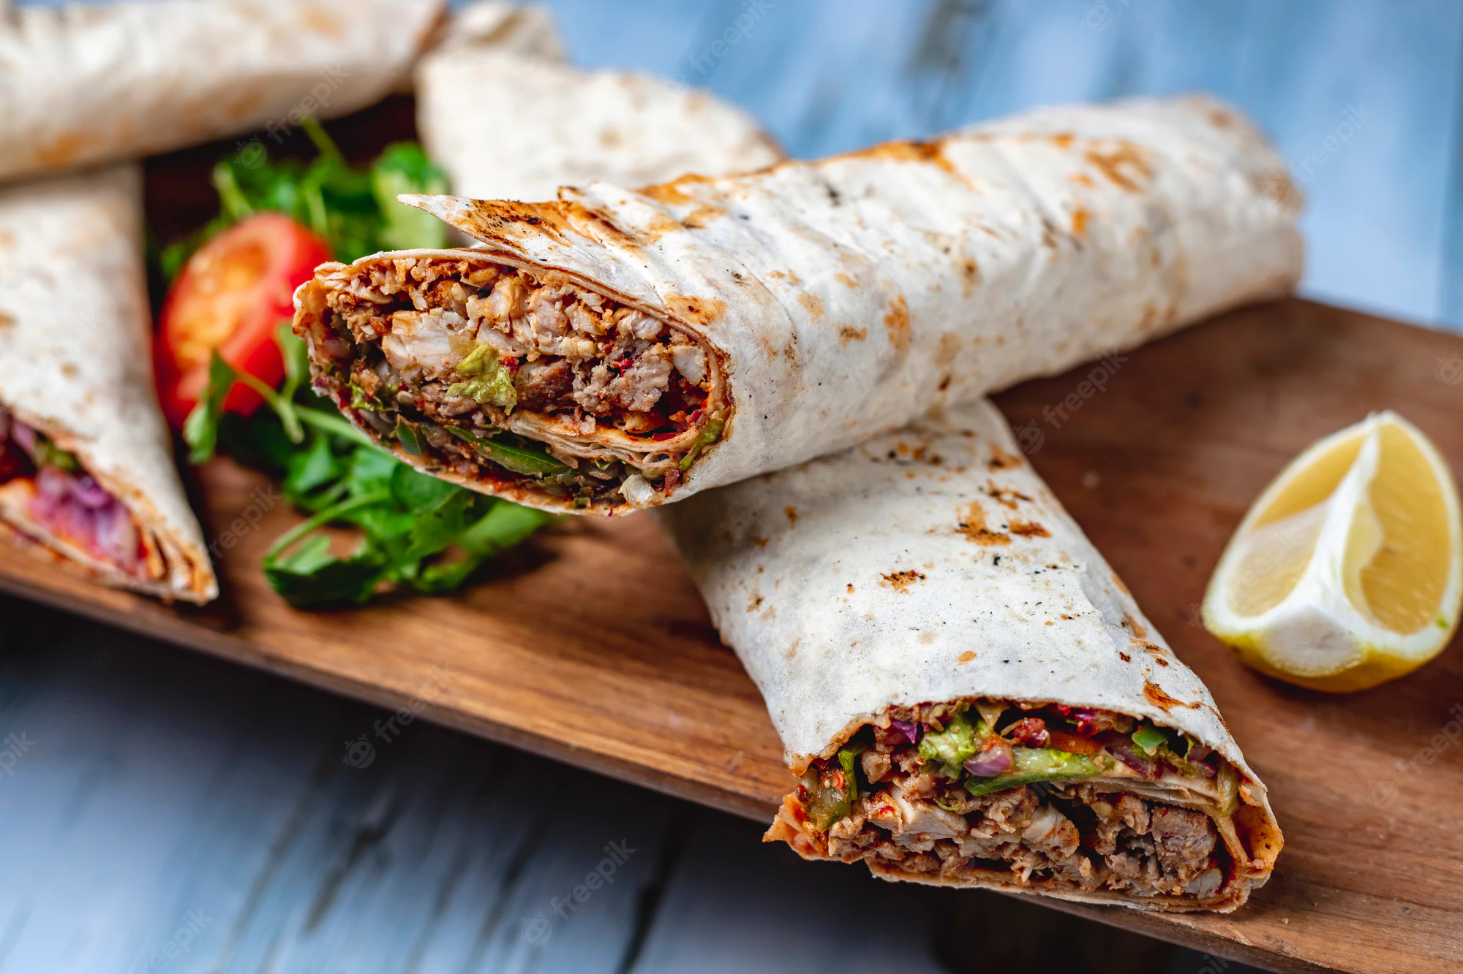
DISADVANTAGES
Time Consuming Process.
Overhead Of Arriving To the Restaurant or Contacting it.
Unusual Disturbance Through Fake Ordering (Through Telephones)
Repeated Intimation By The Administrator To Different Customers.

Slide 15
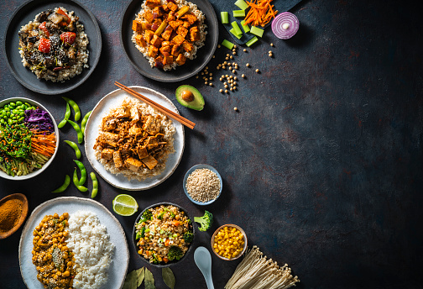
THANK YOU

